Slide 1








Slide 2
Data Analysis On Pre-owned Cars
Team Members Name
Hitesh Nagar
Bekkam Shiva

Slide 3
Contents:
Business Problem
Objective
Web scraping
Website
Library Used
Data Cleaning and Data Manipulation
Summary
EDA(Univariate ,Bivariate & Multi-variate)
Conclusion

Slide 4
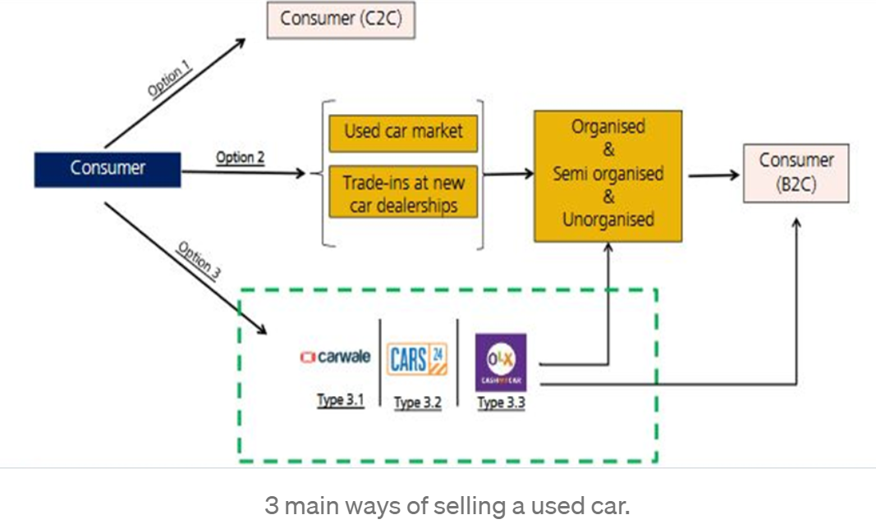
Agenda:
Buisness Problem:

Slide 5
Objective:
Our Analysis basically focuses on the problem faced during this process of selling used cars by third party companies like Carswale, Cars24, Cars.Com
Exploratory Data Analysis on our dataset to understand the relationship between the price of the car and other features of a car.

Slide 6
Web Scraping:
To Extract data using web scraping with python, you need to follow these basic
steps:
URL that you want to scrape.
Inspecting the Page.
Find the data you want to extract.
Write the code.
Run the code and extract the data.
Store the data in the required format.

Slide 7

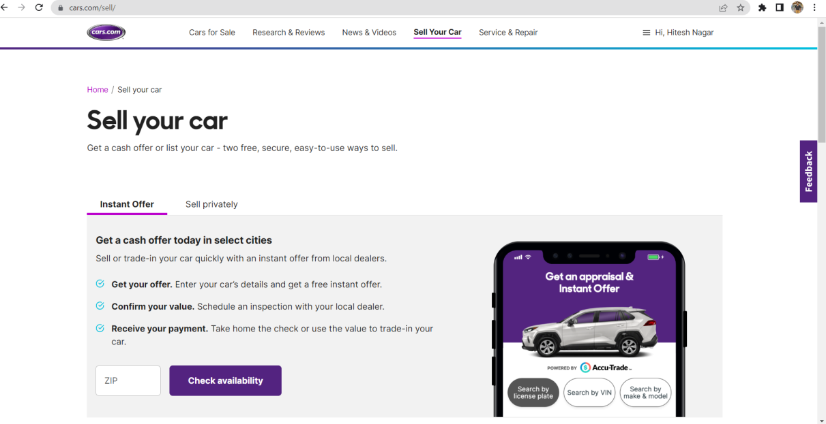
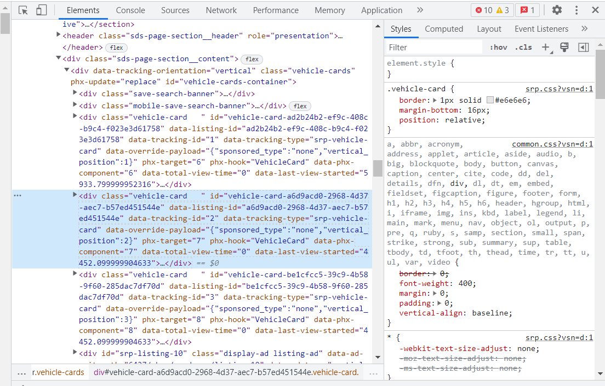
Website:
URL: https://www.cars.com/

Slide 8



Library used:
requests
BeautifulSoup
pandas
Numpy
seaborn
RegEx
matplotlib
plotly

Slide 9
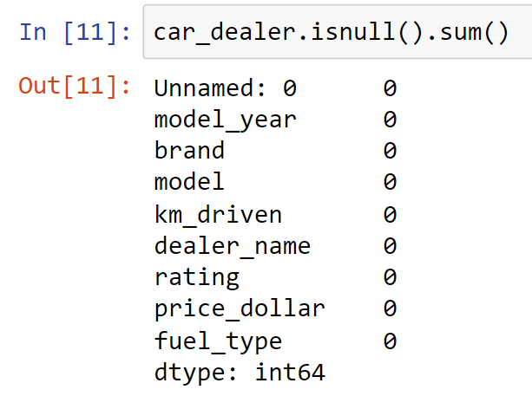
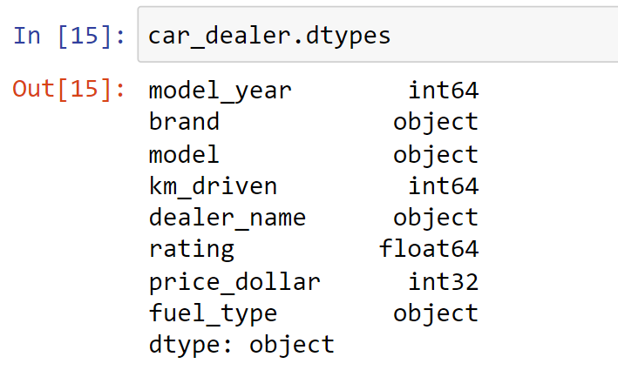
Data Cleaning and Data manipulation:

Slide 10
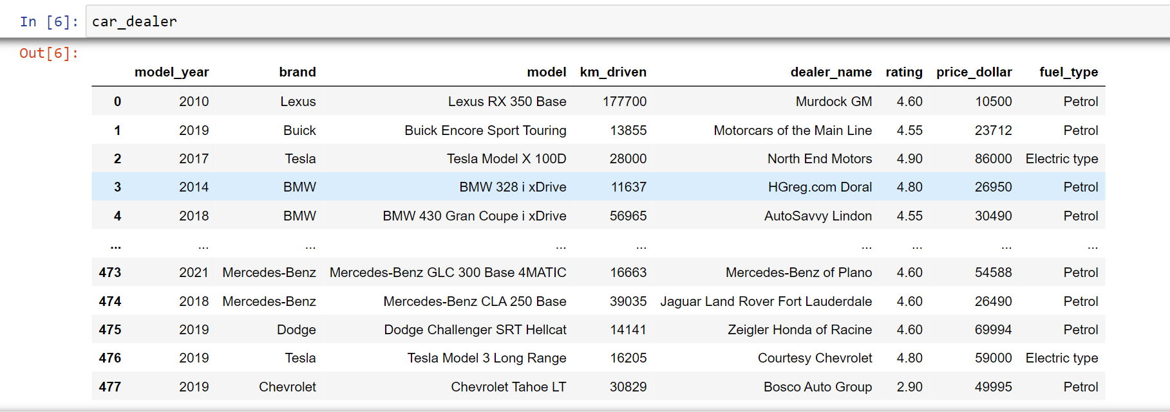
Summary:
From the above libraries and code used ,we are now able to make a data frame ,from which we can use all the information to define the relationship between price and other features of car.
Our Dataset contains 478 unique values and 8 features.(478*8)

Slide 11
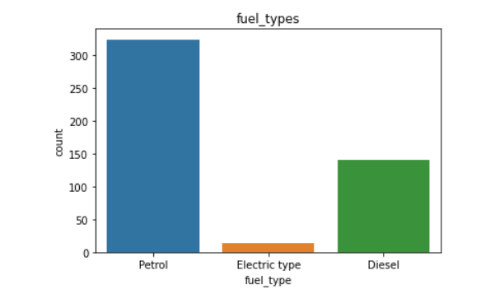
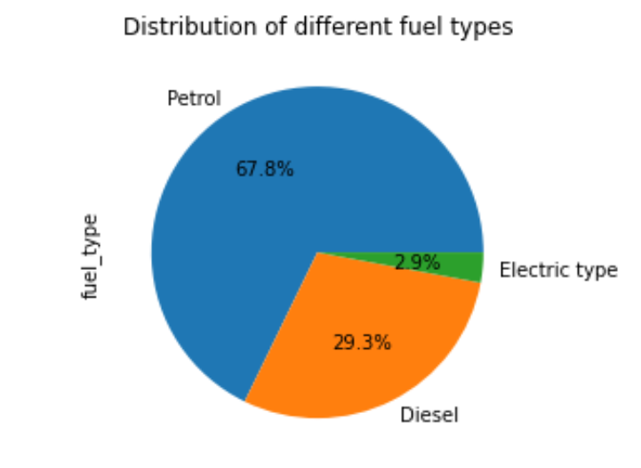
Exploratory Data Analysis(Univariate)
Distribution of different fuel types:

Slide 12
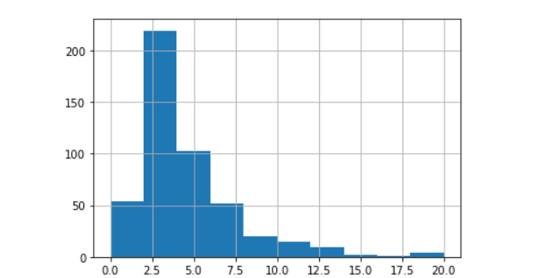
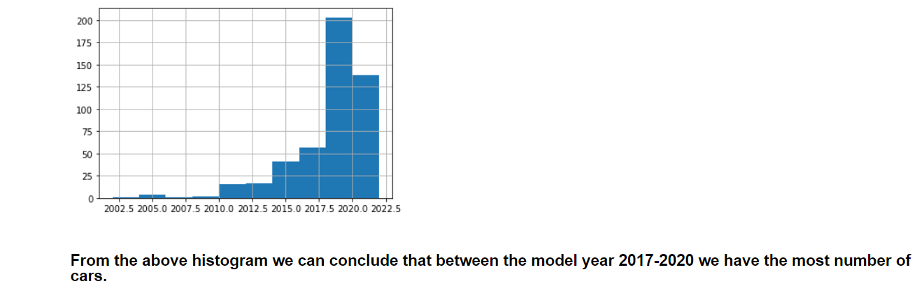
Age of most cars(Univariate)

Slide 13
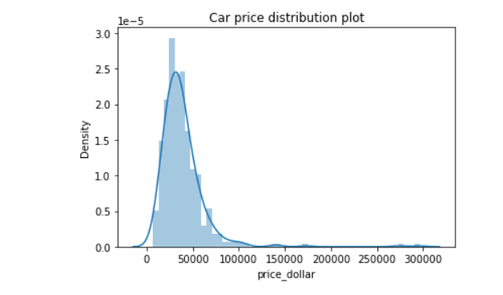
price of most cars(Univariate)
Most car lies between 20k$ to 50k$ price range.

Slide 14
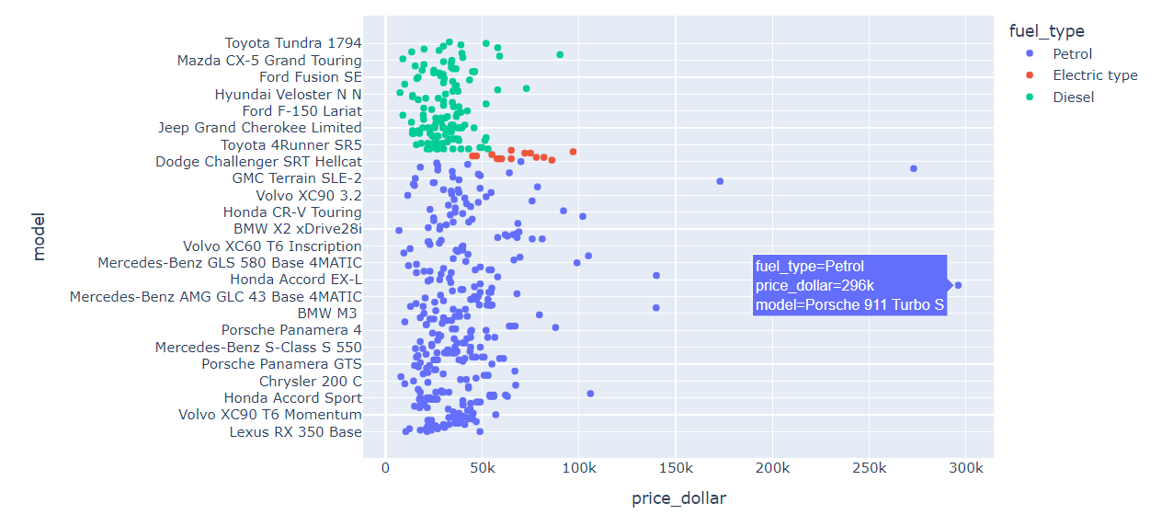



Car with highest price in each type(multi-variate) From the below graph we can conclude that the following model have the highest prices: petrol= Porsche 911 Turbo S Diesel= Ford F-250 Lariat Electric=Tesla Model X Long Range

Slide 15
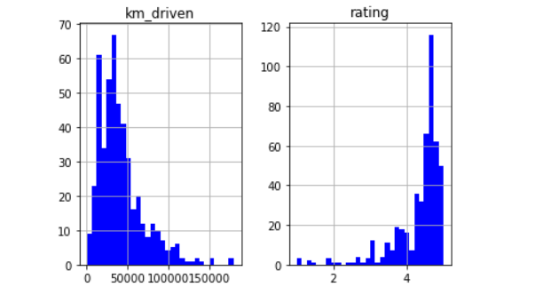
Number of cars on the basis of kmdriven and Rating(Univariate)

Slide 16
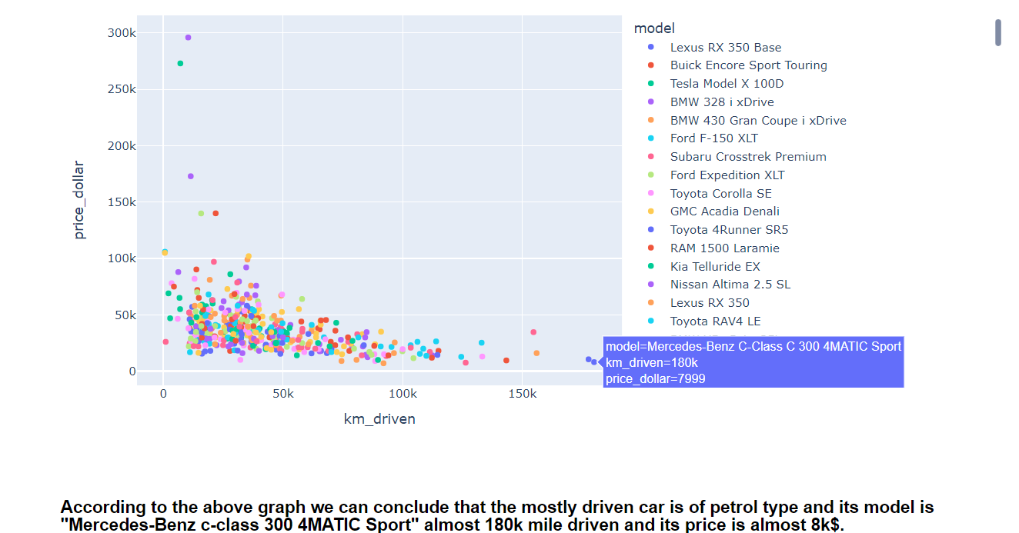

Relation between highest km_driven and price of the car(multi-variate)

Slide 17
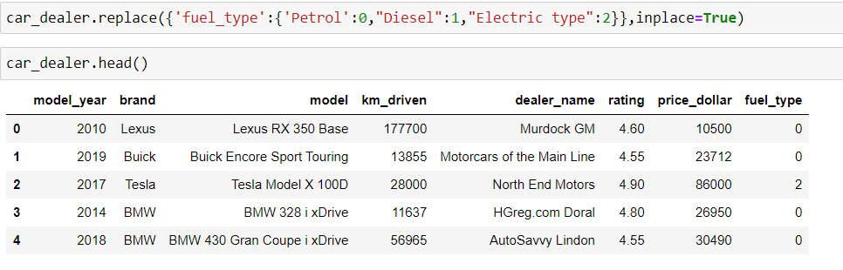
To find the correlation we changed the fuel_type column to numeric

Slide 18
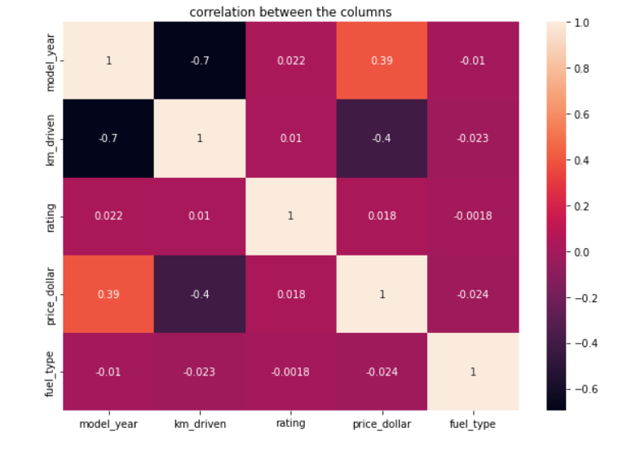
Correlation between the prices and all the features of the car(Multi-variate)

Slide 19
Conclusion
From the above observation we can say that the price of our car positively correlated with the model year and the rating of the car so to grow our business the first thing we have to consider is to the model year of the car .

Slide 20

THANK YOU

